Slide 1
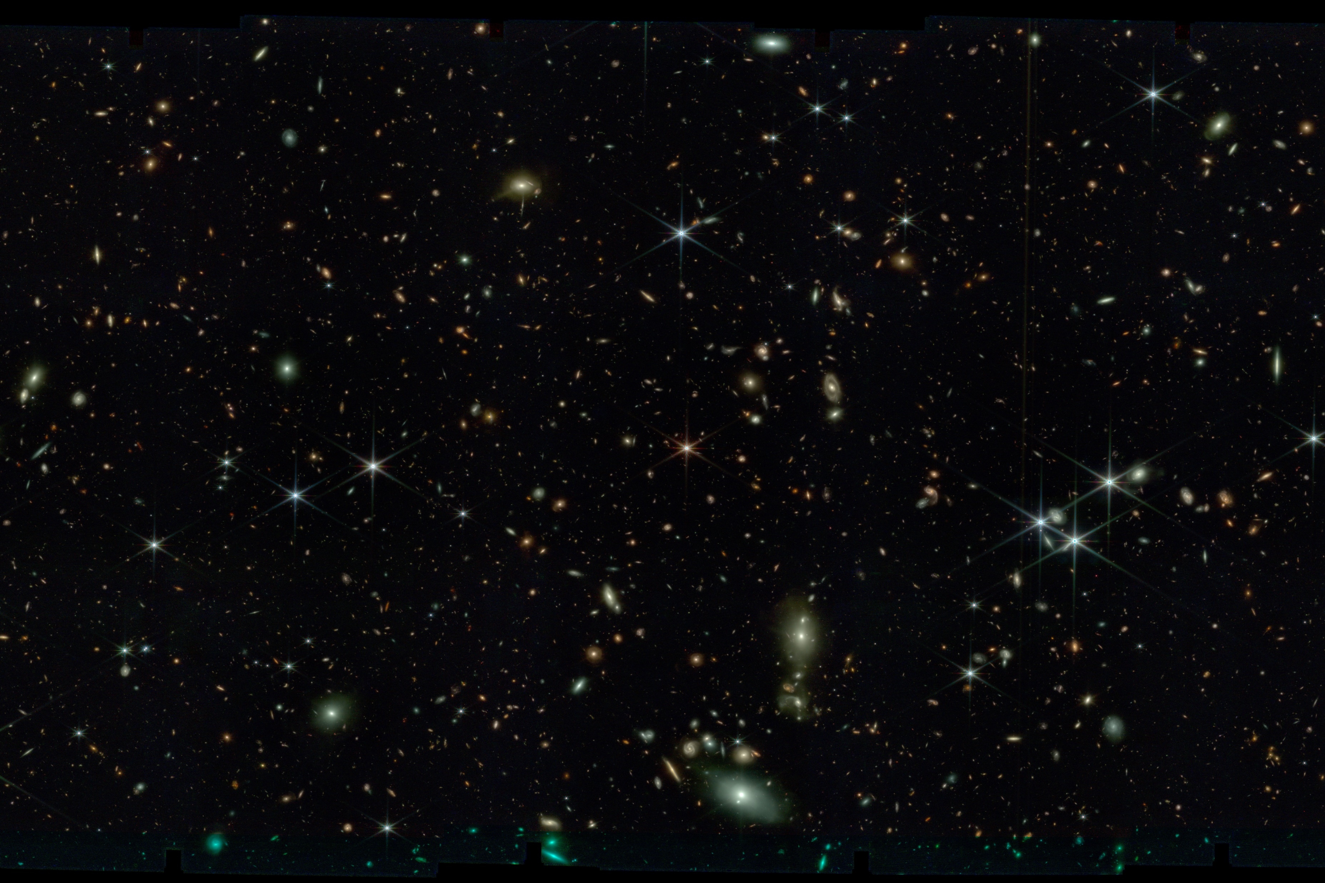


Slide 2
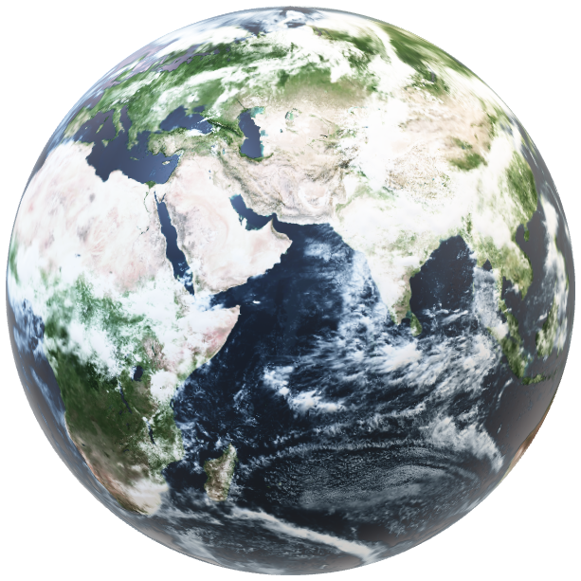
Liquid Water

Slide 3
Liquid Water

